Slide 1
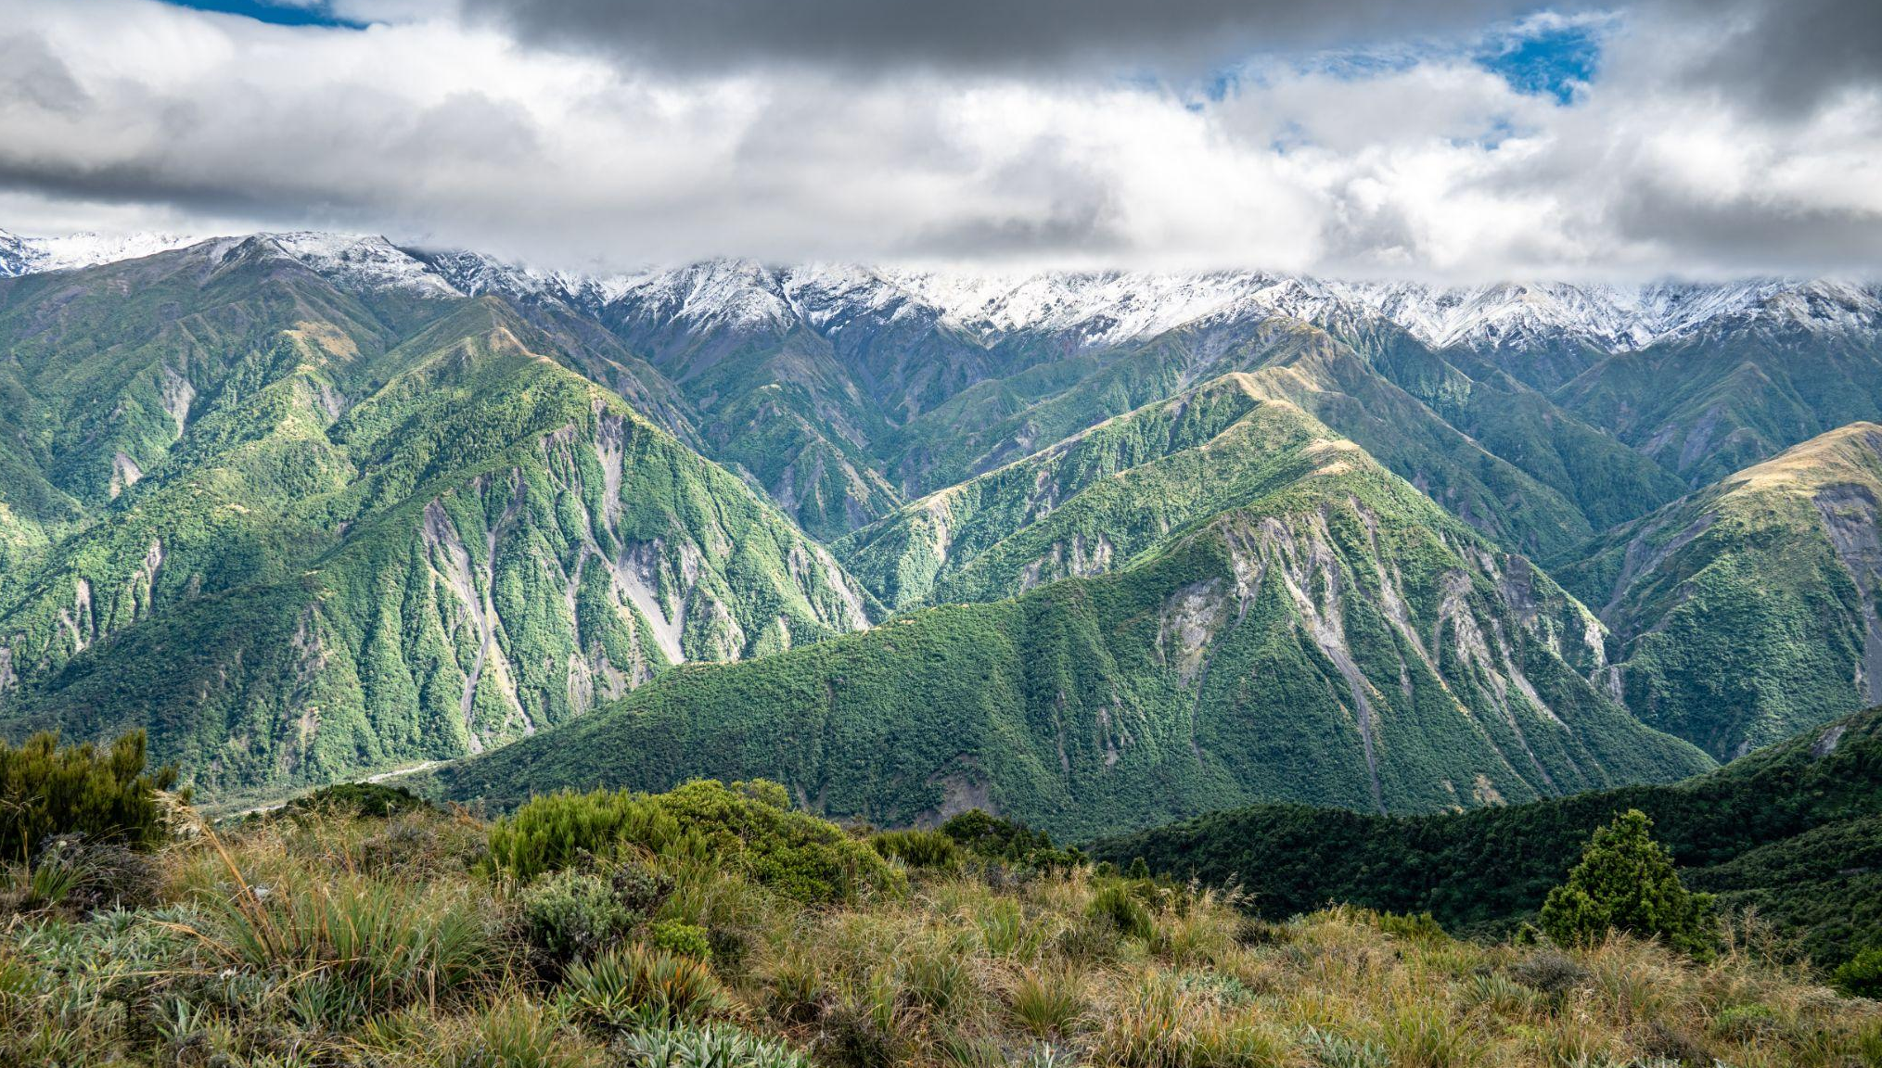

Earthquake triggered landslide reactivations: Kaikoura, NZ
Geospatial Data Analysis with Python, Final Presentation
Paul Morgan, Luis Angel Guerrero Hoyos, Alan Viola

Slide 2
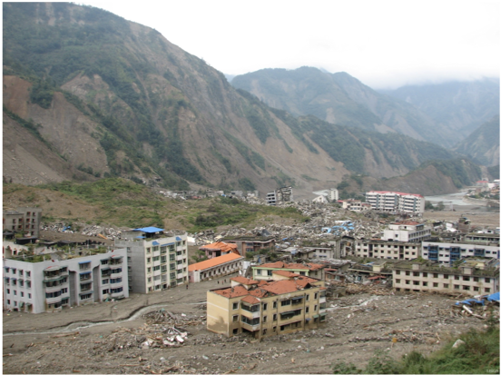
The hazard isn’t over just because the shaking is over
Reactivated landslides are a serious hazard
After the 2008 Wenchuan Earthquake, post landslide debris flows caused serious destruction
Post Earthquake debris flow, 2008 Wenchuan Earthquake
-Photo- David Wald, USGS

Slide 3
But what happened after the initial landslides…
A case study using the 2016 Kaikoura Earthquake
Goals:
1: Track Reactivations, Where do landslides fail again?
> Asses which landslides were reactivated though land surface level changes from multiple post-event Lidar acquisitions.
2: Does vegetation control reactivations?
> Use NDVI analysis in concert with our landslide dataset
3: Does morphology control reactivations?
> Use digital elevation model morphometric analysis in concert with our landslide dataset

Slide 4
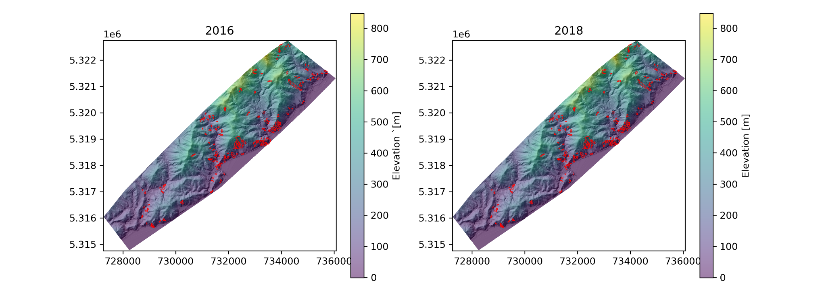
Raw Data: DEMs + Landslide Inventory
NGS - Linz - OpenTopography
Deal with storage - 2Tb of data (HUB - Repo limitations)
Clipped an area of interest
In red, the landslide inventory (right after the earthquake)
Notes:
NGS - Linz - OpenTopography
Deal with storage - 2Tb of data
Clipped an area of interest
In red it is plotted the landslide inventory (right after the earthquake)

Slide 5
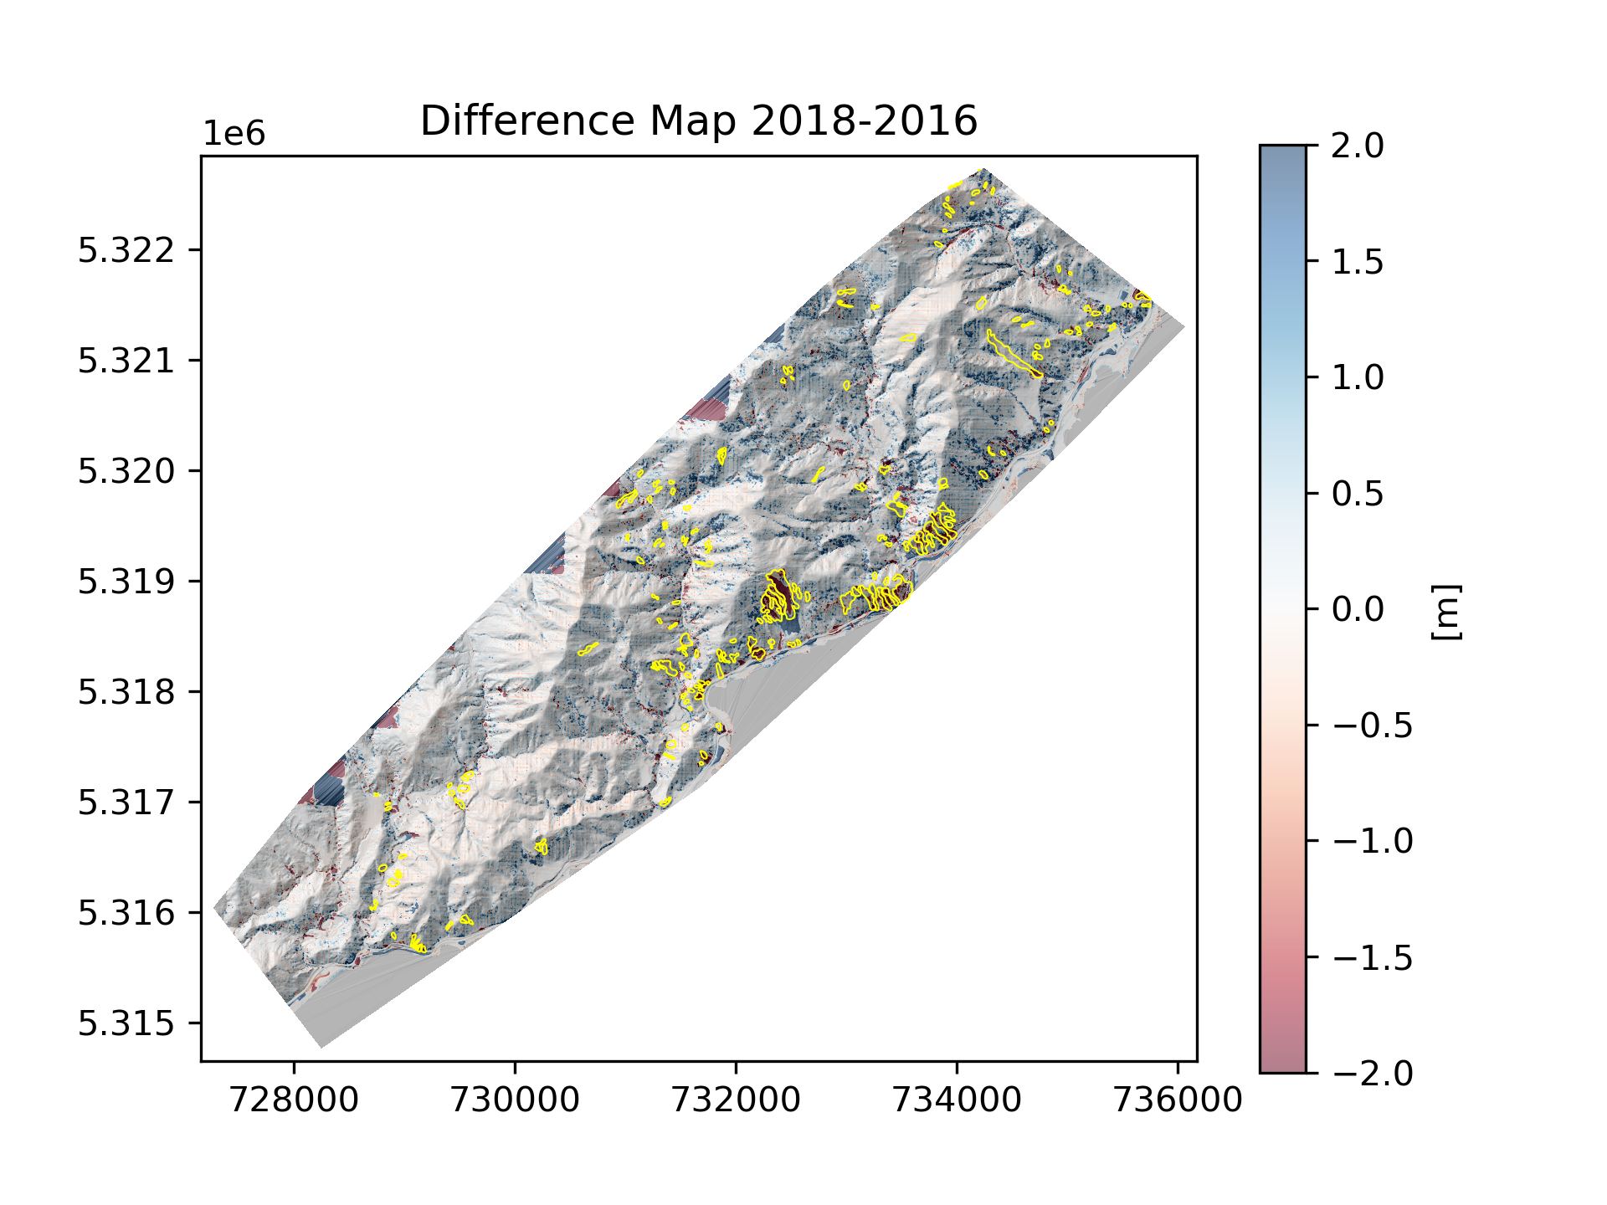
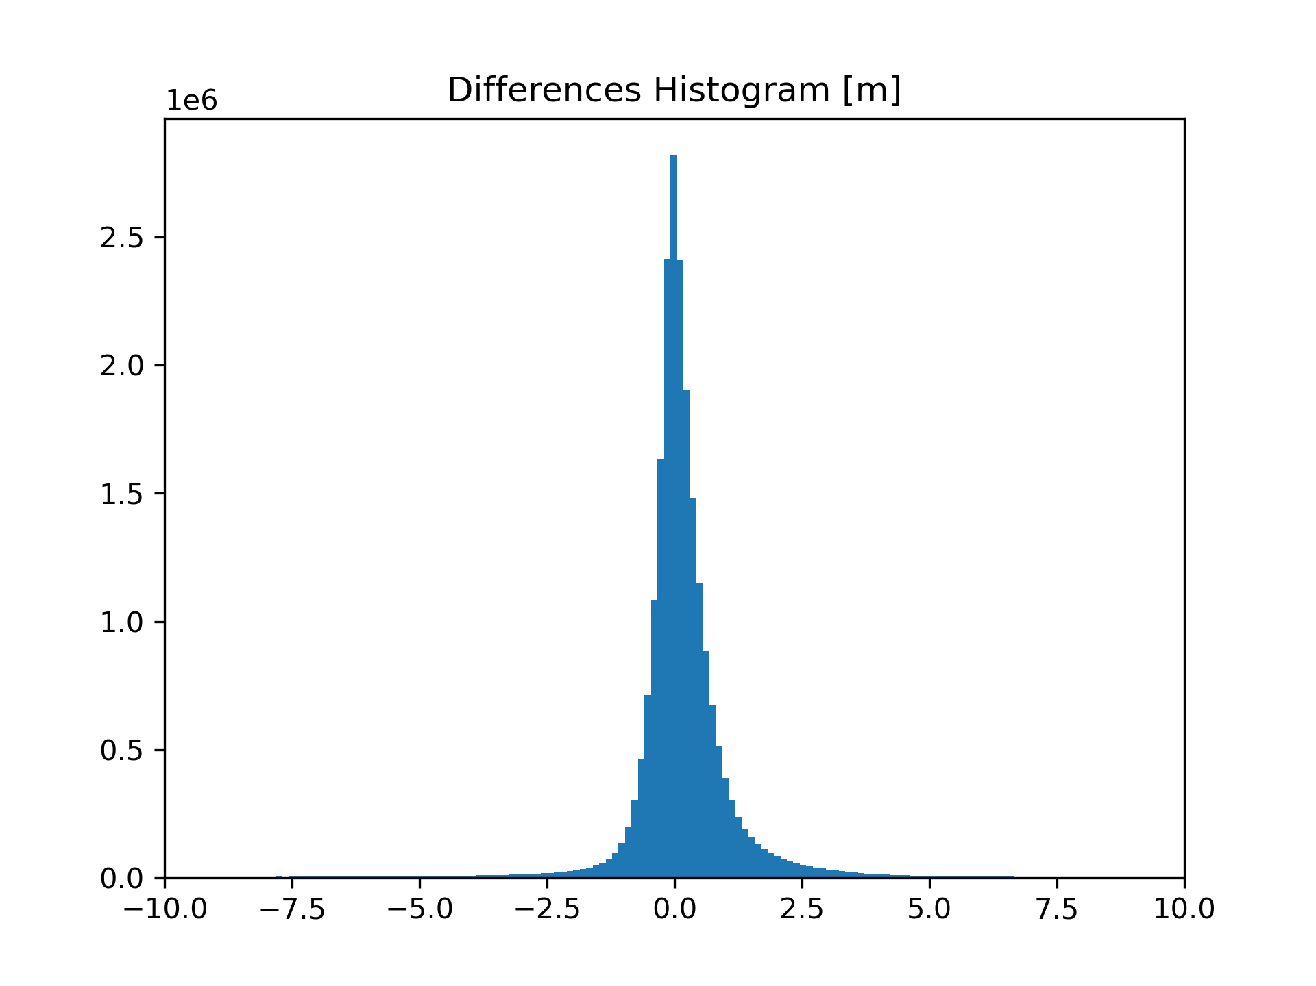
DEM differencing!
One issue we encountered was that raster did not have the same shape to do the differencing.
Clipped the raster to a the same shape.
Sanity check (distribution has its peak in zero) - DEMs have the same elevation datum.
stuff 2
Notes:
One issue we encountered was that raster did not have the same shape to do the differencing.
Clipped the raster to a the same shape.
Sanity check (distribution has its peak in zero) - DEMs have the same elevation datum.

Slide 6
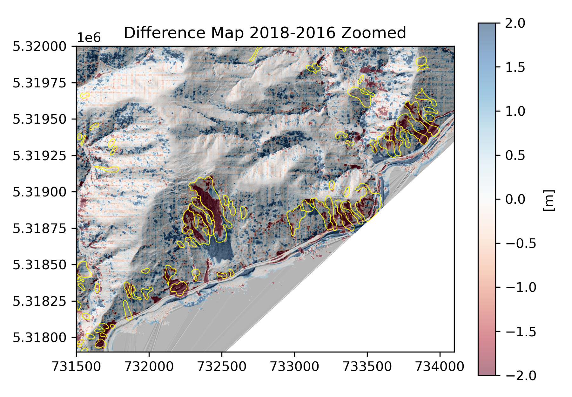
Zoomed DEM differencing!
Zoomed into a more interesting area
Note areas of loss of elevation, and gained elevation.
Notes:
zoomed into a more interesting area
note areas of loss of elevation, and gained elevation.

Slide 7
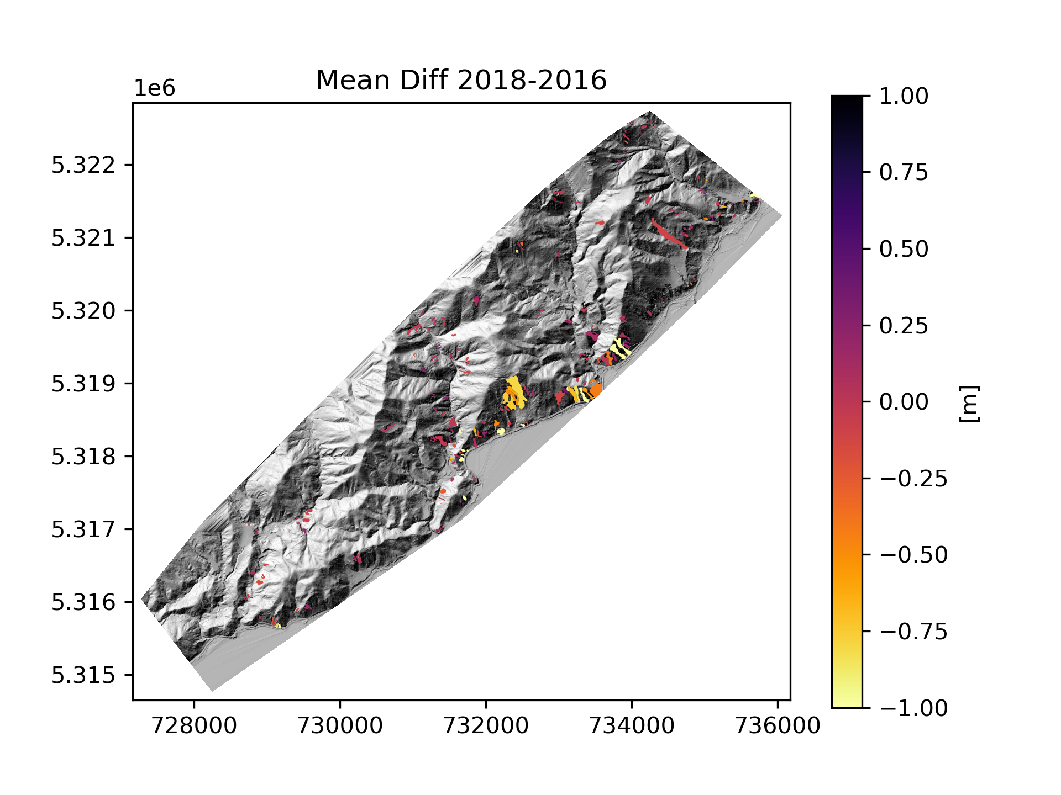
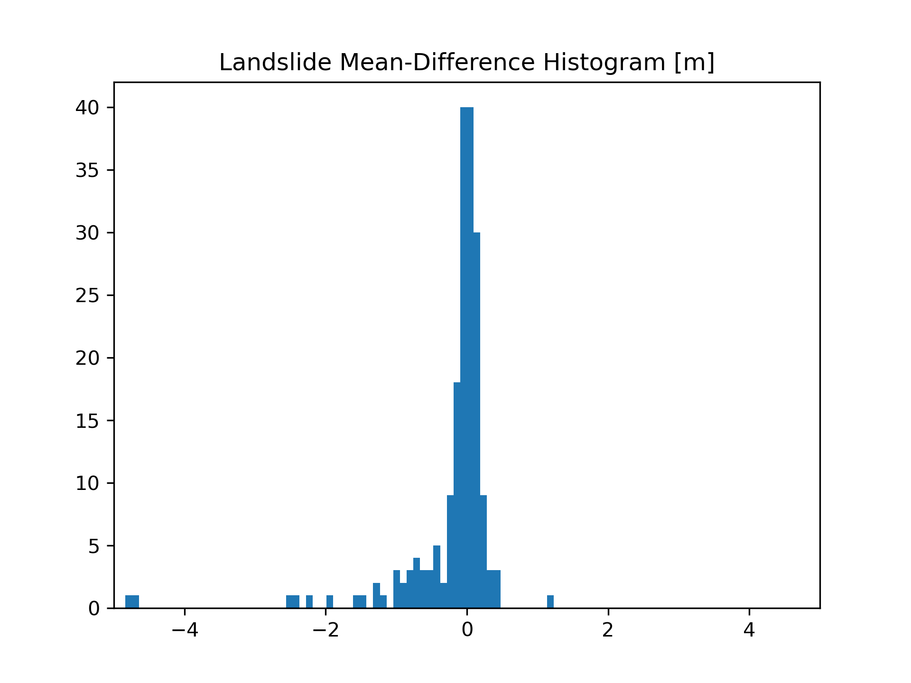
Difference Raster Sampling by Landslide
Then we sampled the difference map with the landslide inventory using the mean value
stuff 2
Notes:
then we sampled the difference map with the landslide inventory using the mean value

Slide 8
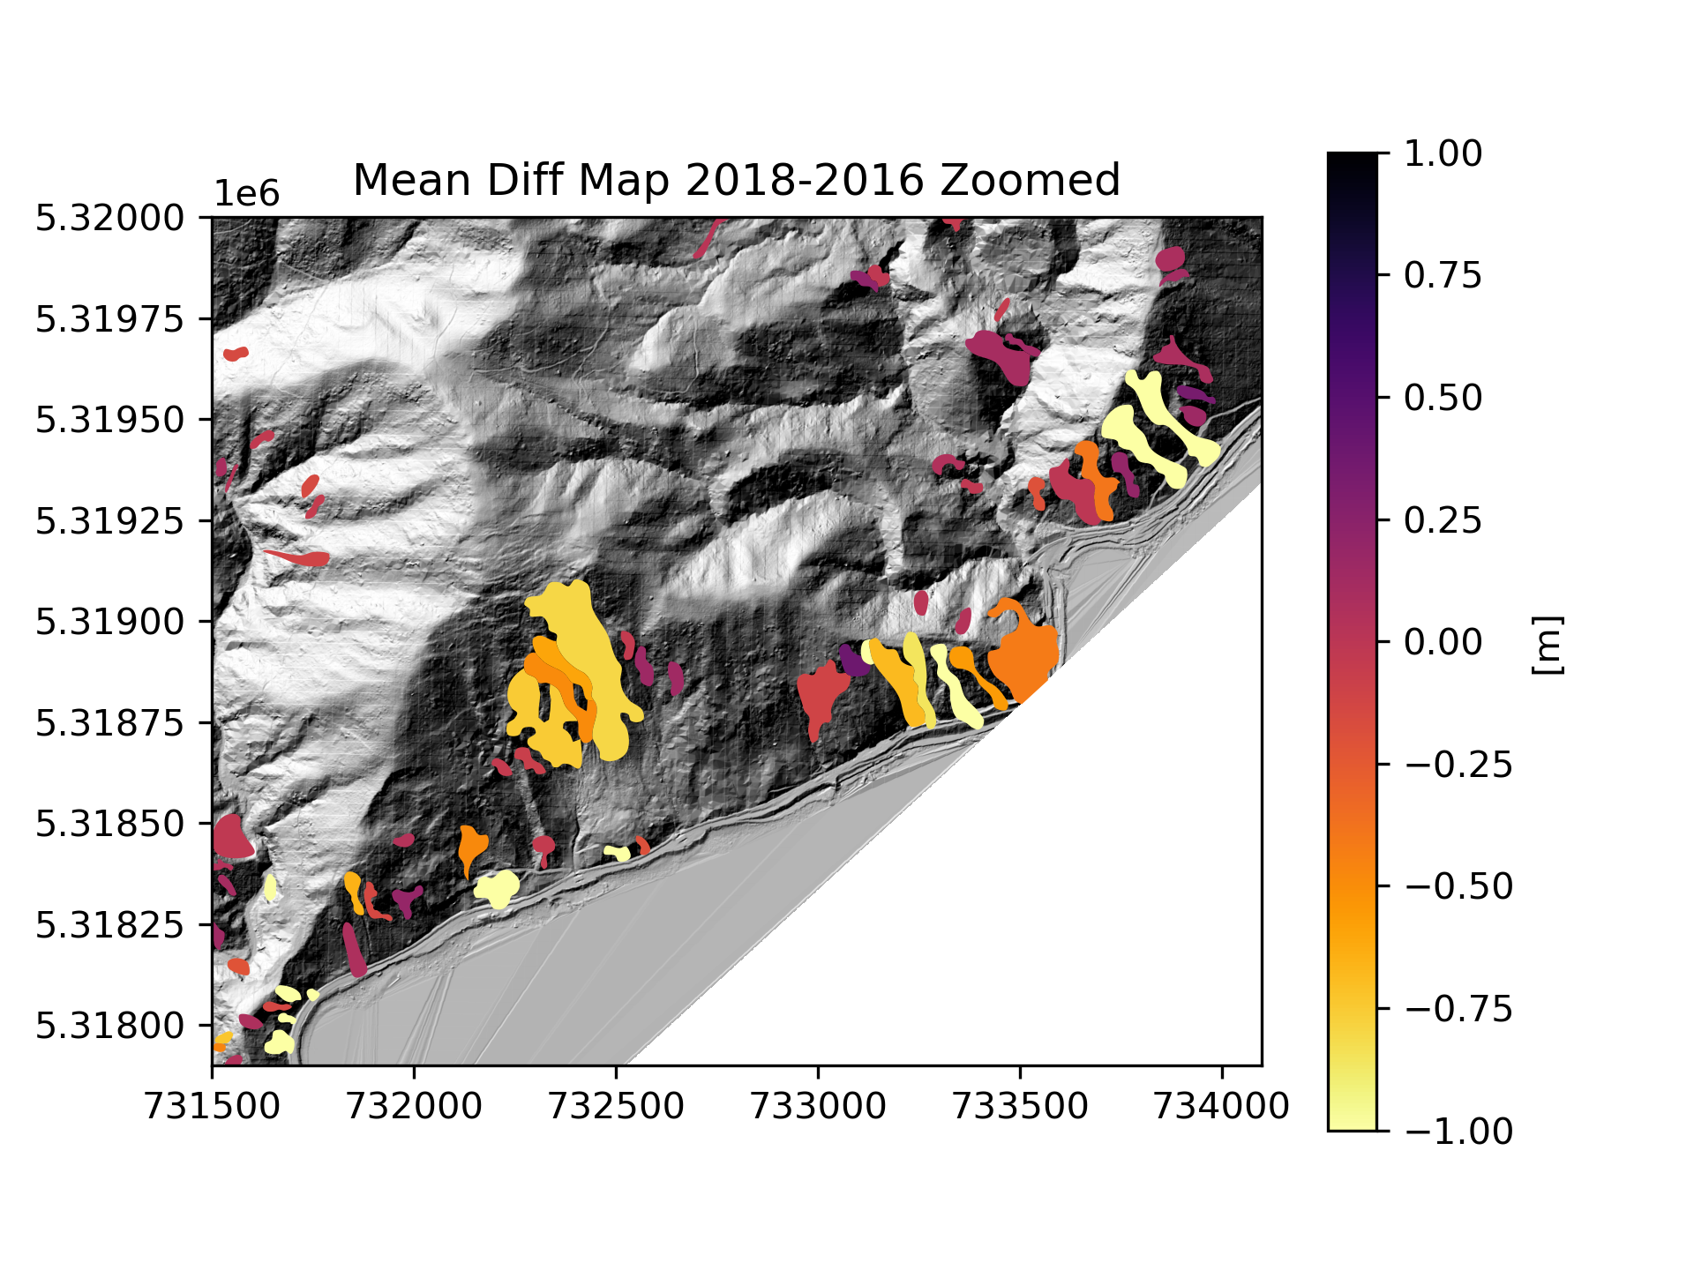
Zoomed Difference Raster Sampling by Landslide
55% of landslides have negative mean difference (note that some of these are not indeed reactivations - some removals had to be done for reads to be reactivated in some cases)
Notes:
55% of landslides have negative mean difference (note that some of these are not indeed reactivations - some removals had to be done for reads to be reactivated in some cases)

Slide 9
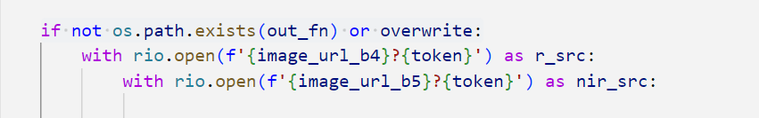
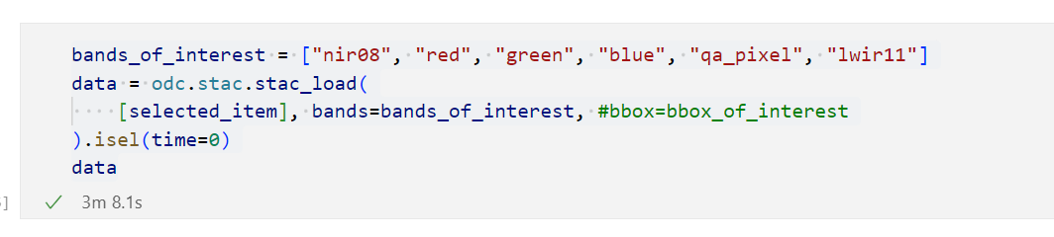
NDVI Data Download
Data Source: Microsoft Planetary computer
Original approach: rio.open
Lots of errors, inconsistent 404s
New approach: odc.stac
Better results!

Slide 10
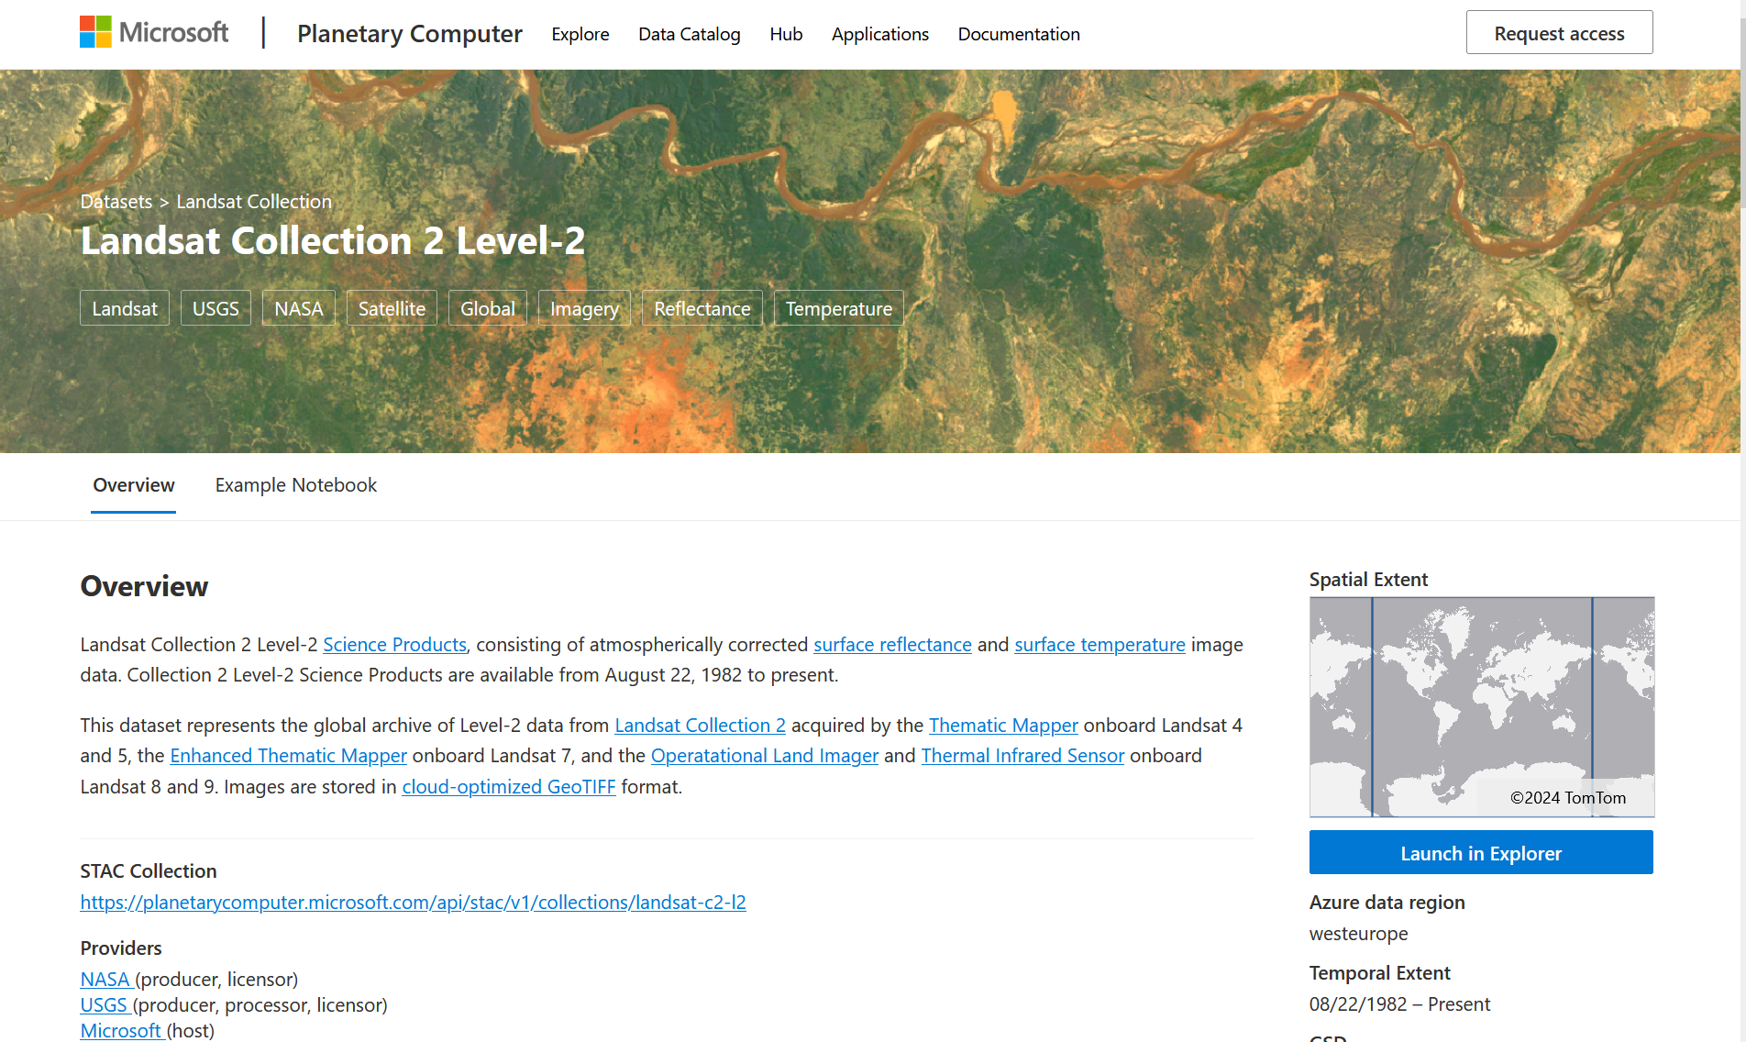

Slide 11
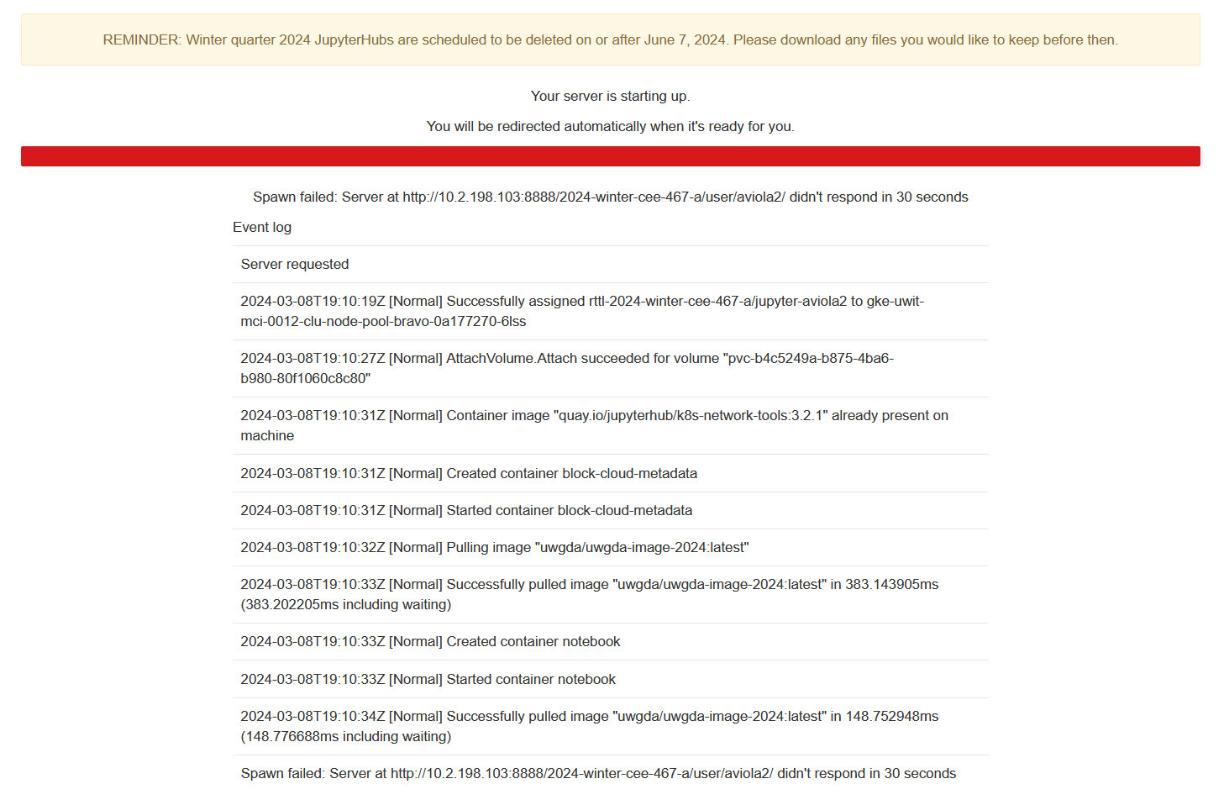
Challenges: I bricked my Jupyterhub!

Slide 12
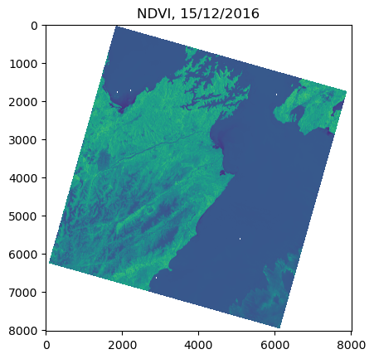
NDVI

Slide 13
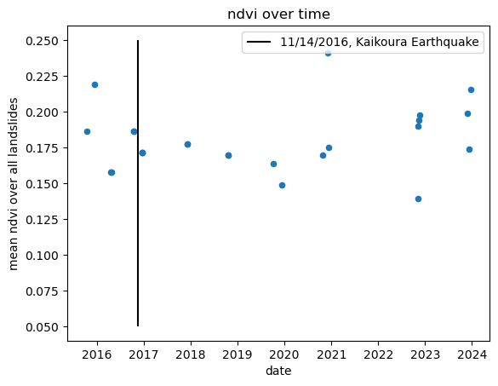
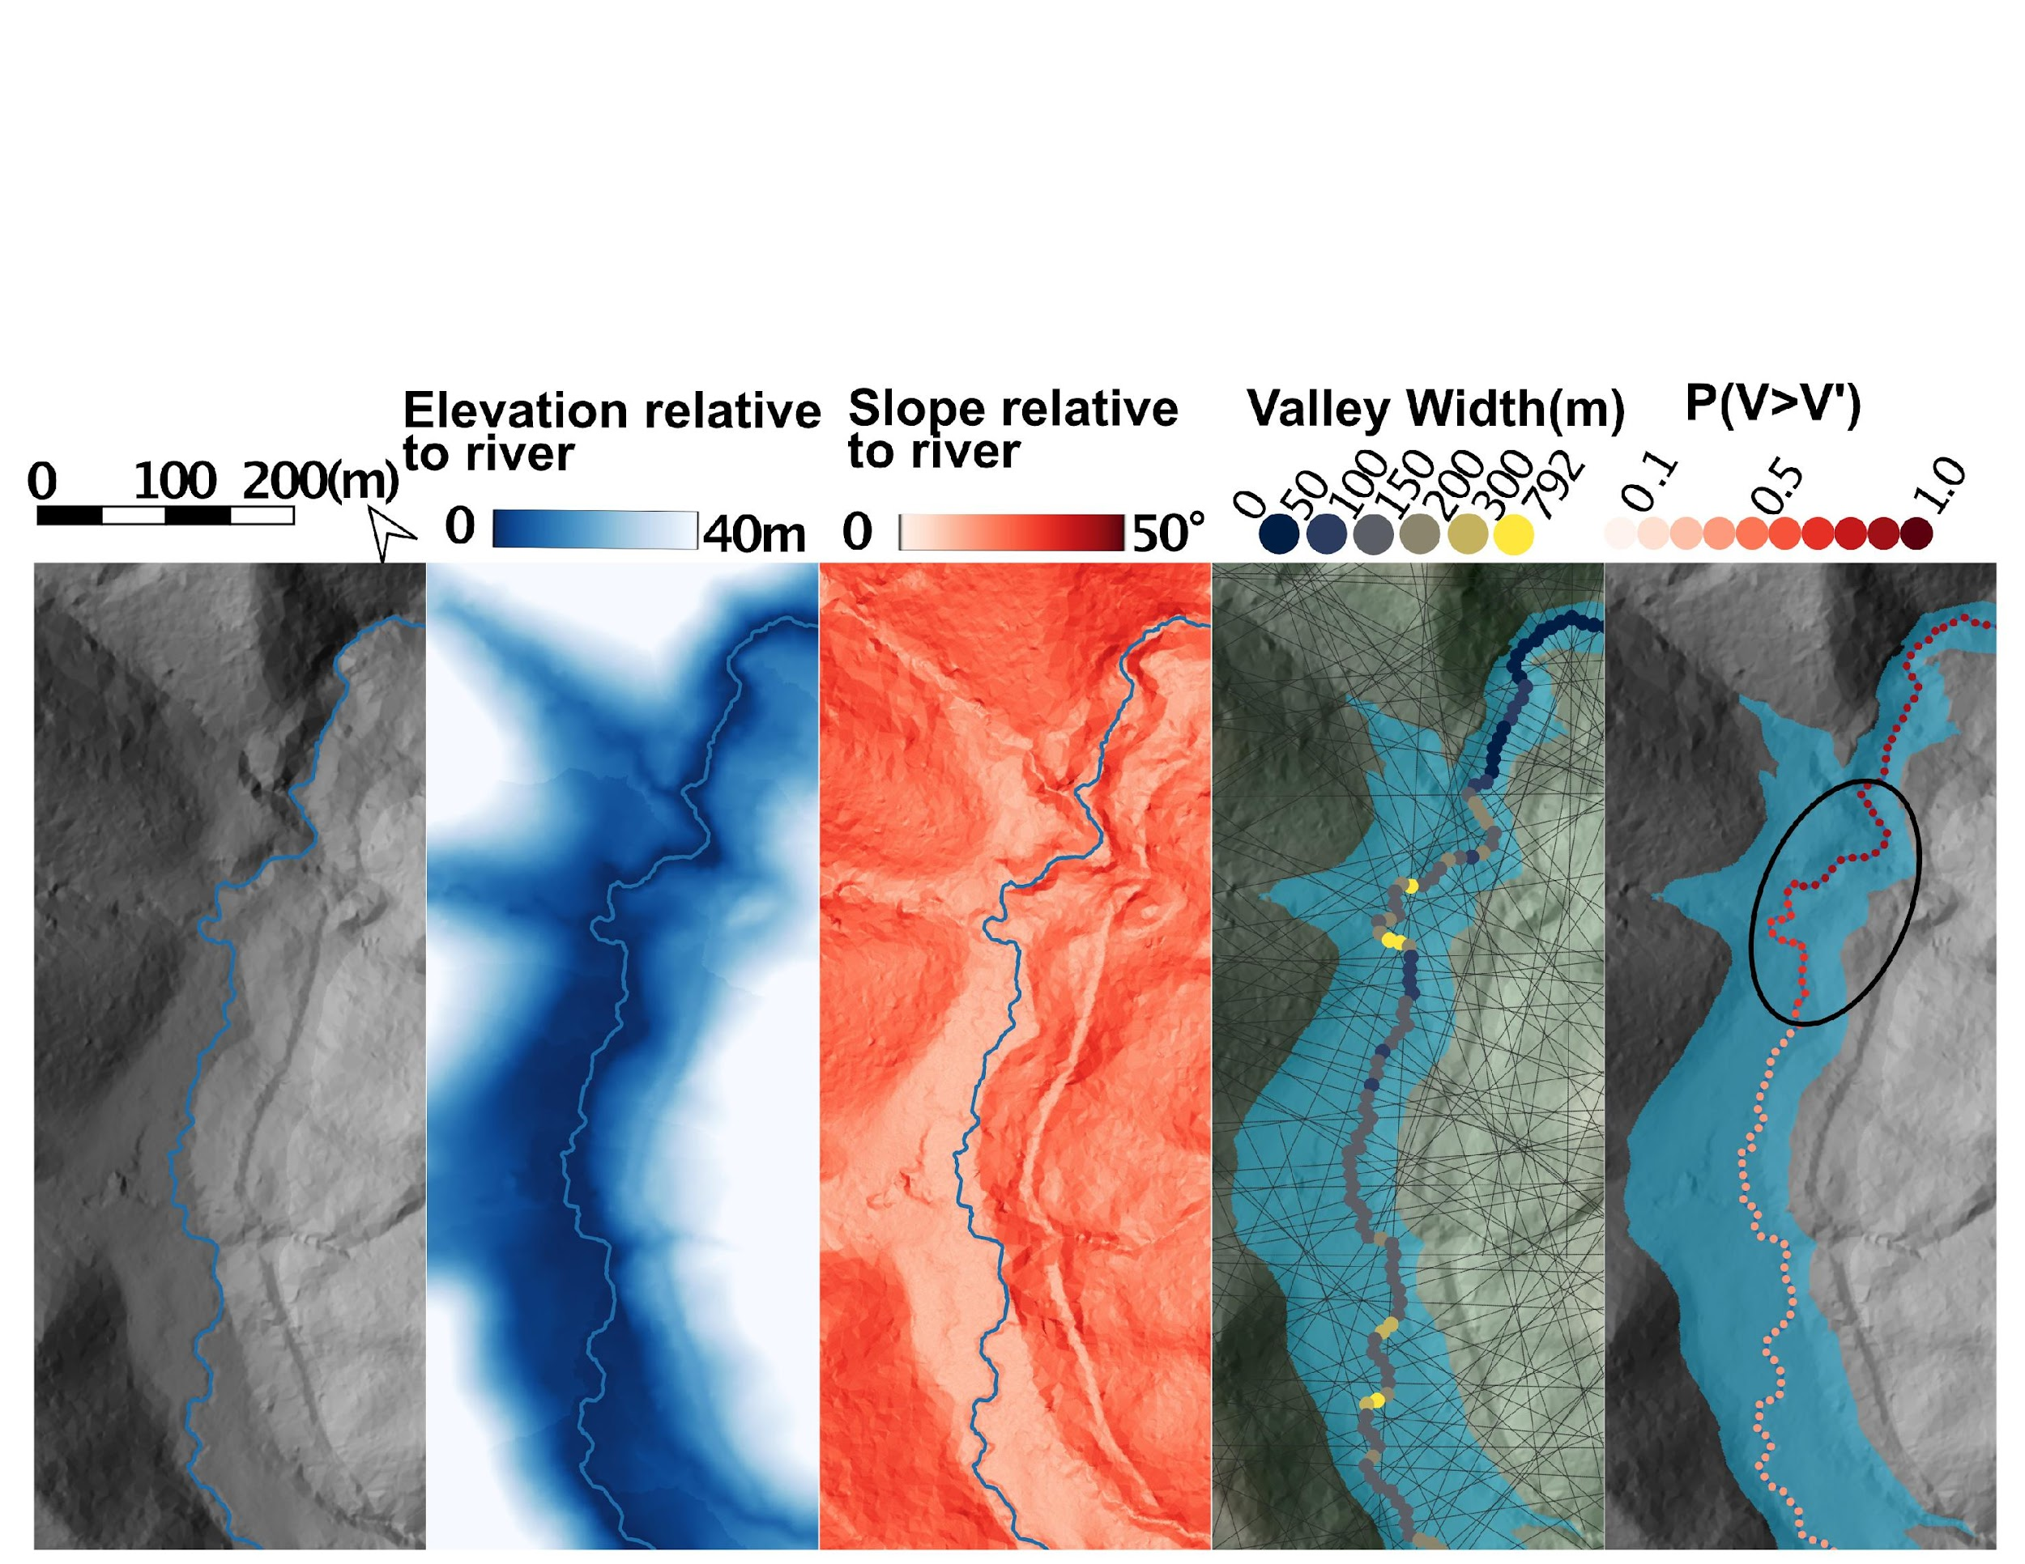
NDVI
Tracking ndvi over time over all landslides.
Data from landsat collection 2 imagery taken in October, November, or December with cloud cover <10%
No clear change in NDVI after earthquake

Slide 14
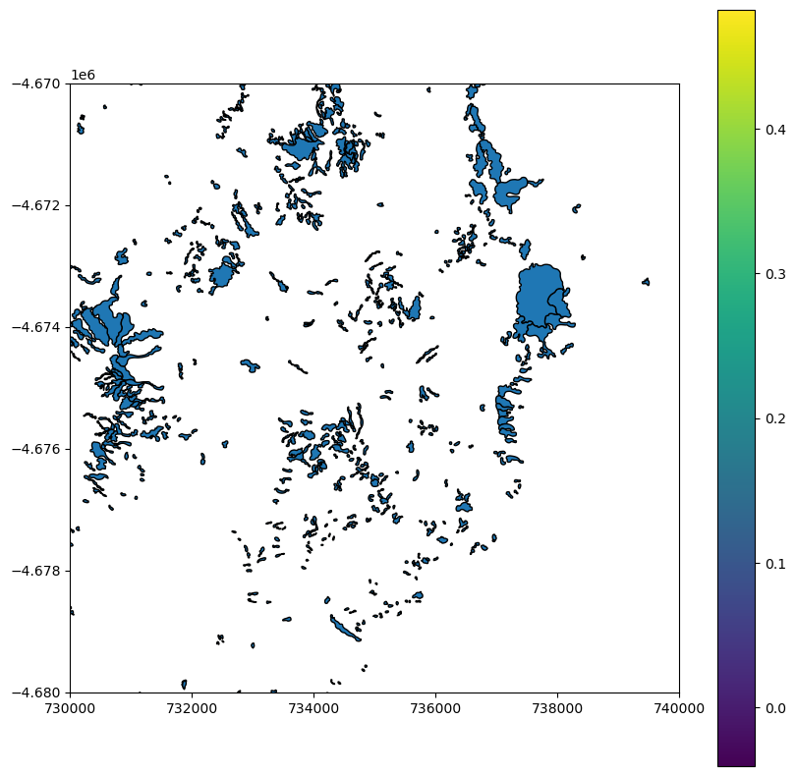
NDVI
Mean NDVI per polygon

Slide 15
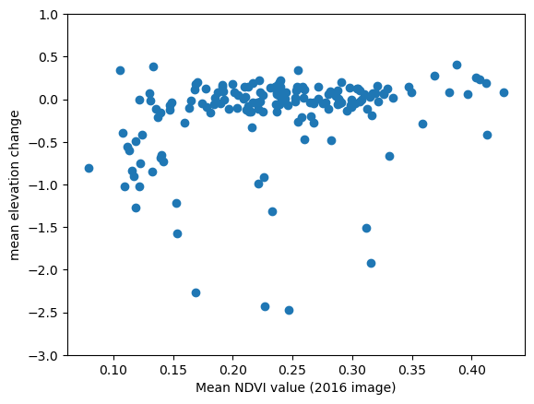
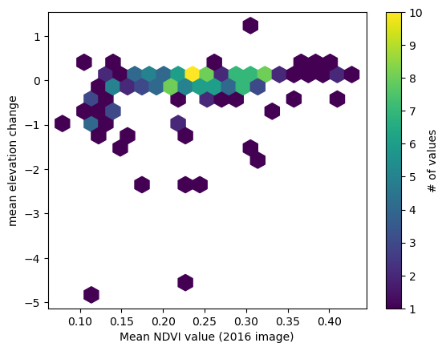
Does NDVI correlate with reactivation
We might see more movement in less plant areas
Less movement
more
plants
less plants
more movement
The same data in two plots

Slide 16
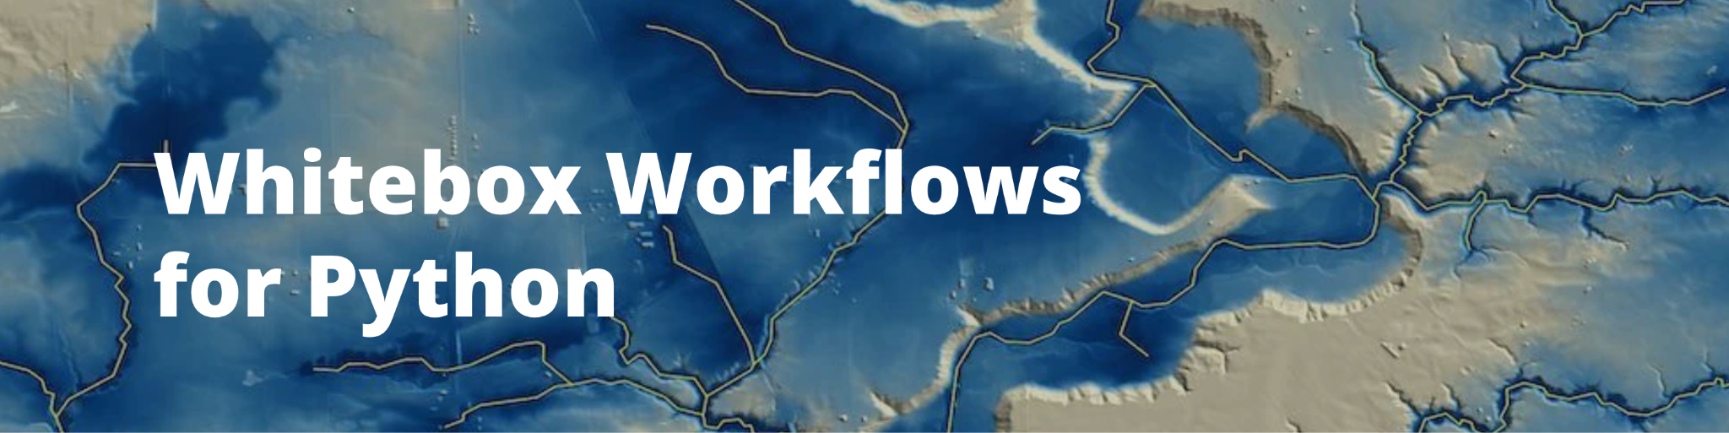
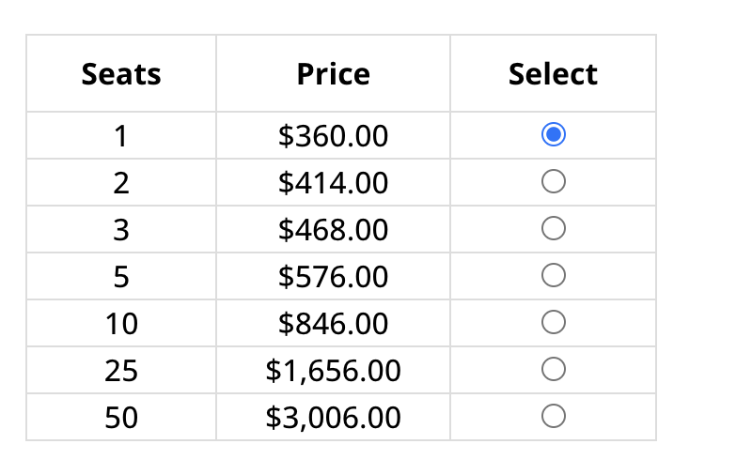

DEM analysis
I found a new (to me) landscape analysis toolset
The first paid Python package I’ve seen? Fortunately many of their tools are still free

Slide 17
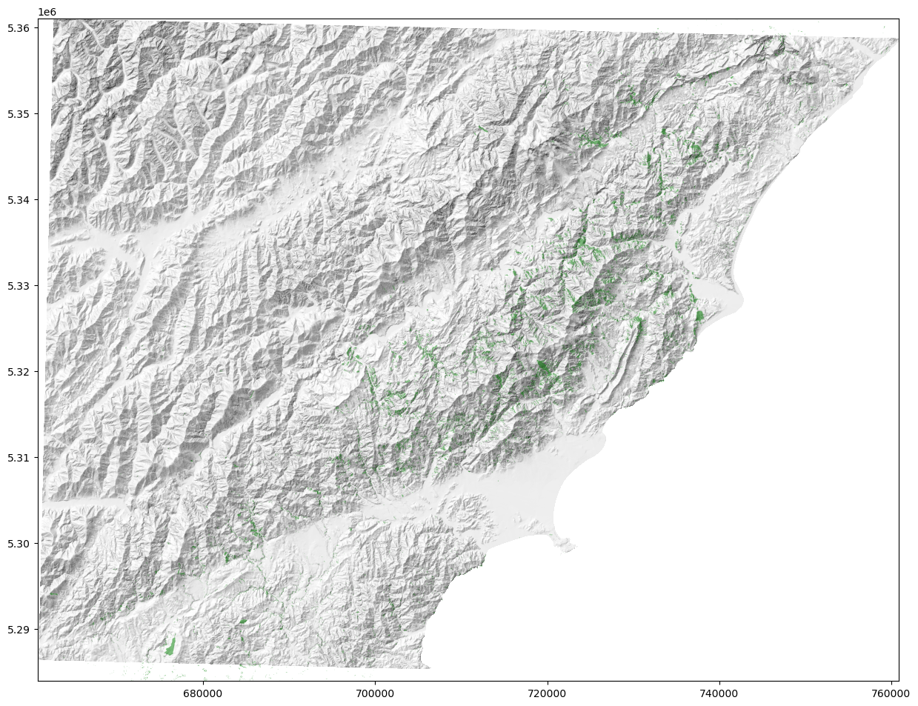
A pretty hillshade
Goals-
-Extract DEM info at the landslides
-assess hillslope position of the landslides

Slide 18
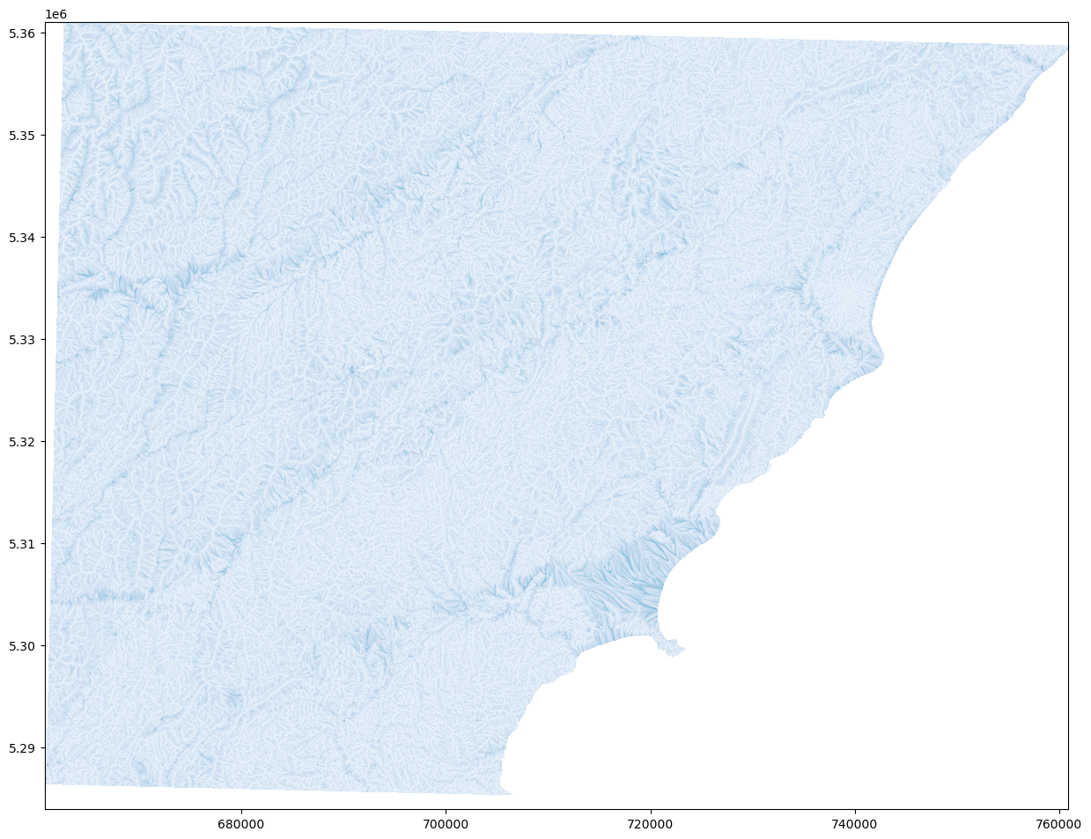
flow accumulation

Slide 19
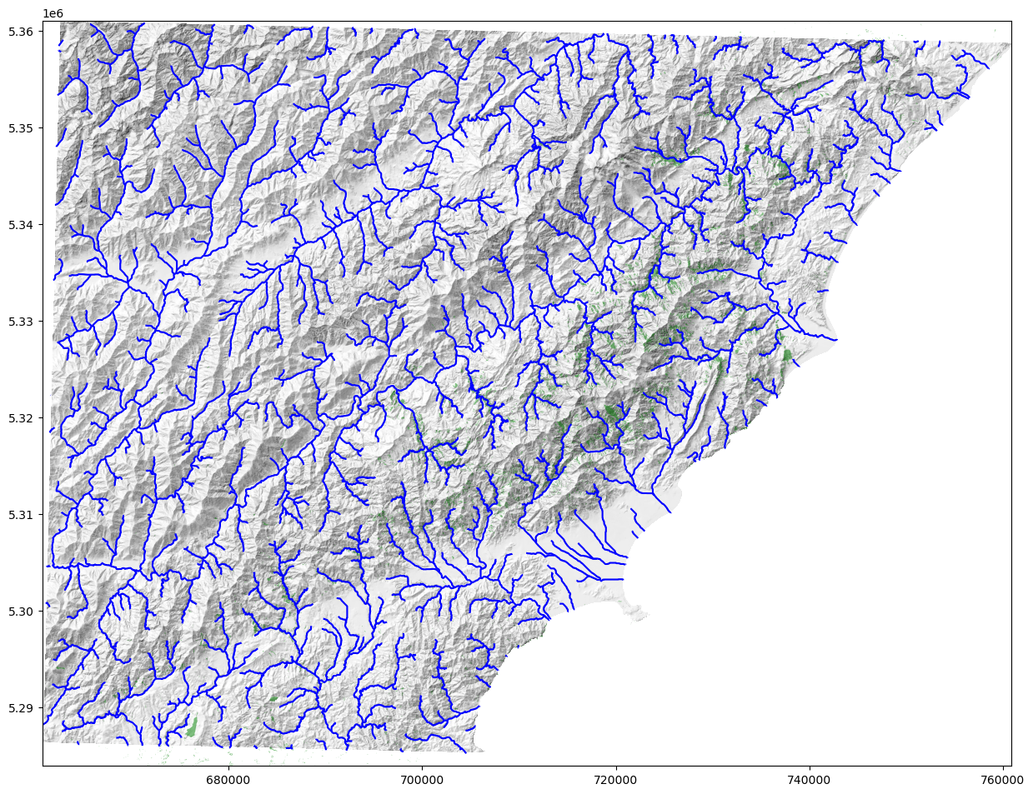
Flow Routing

Slide 20
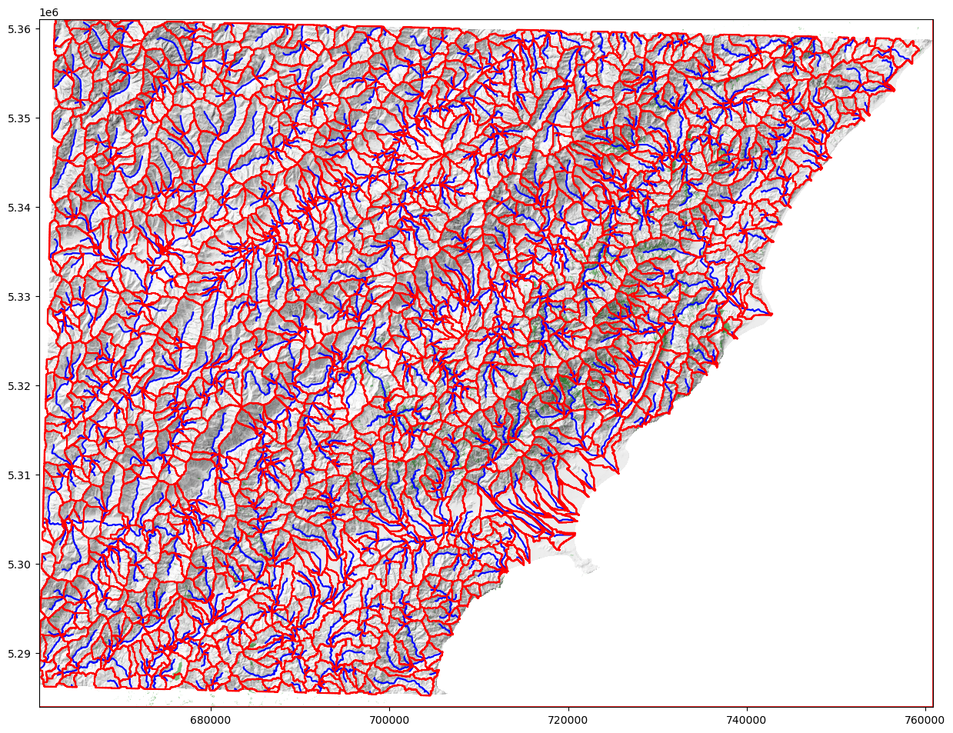
Subcatchement delineation

Slide 21
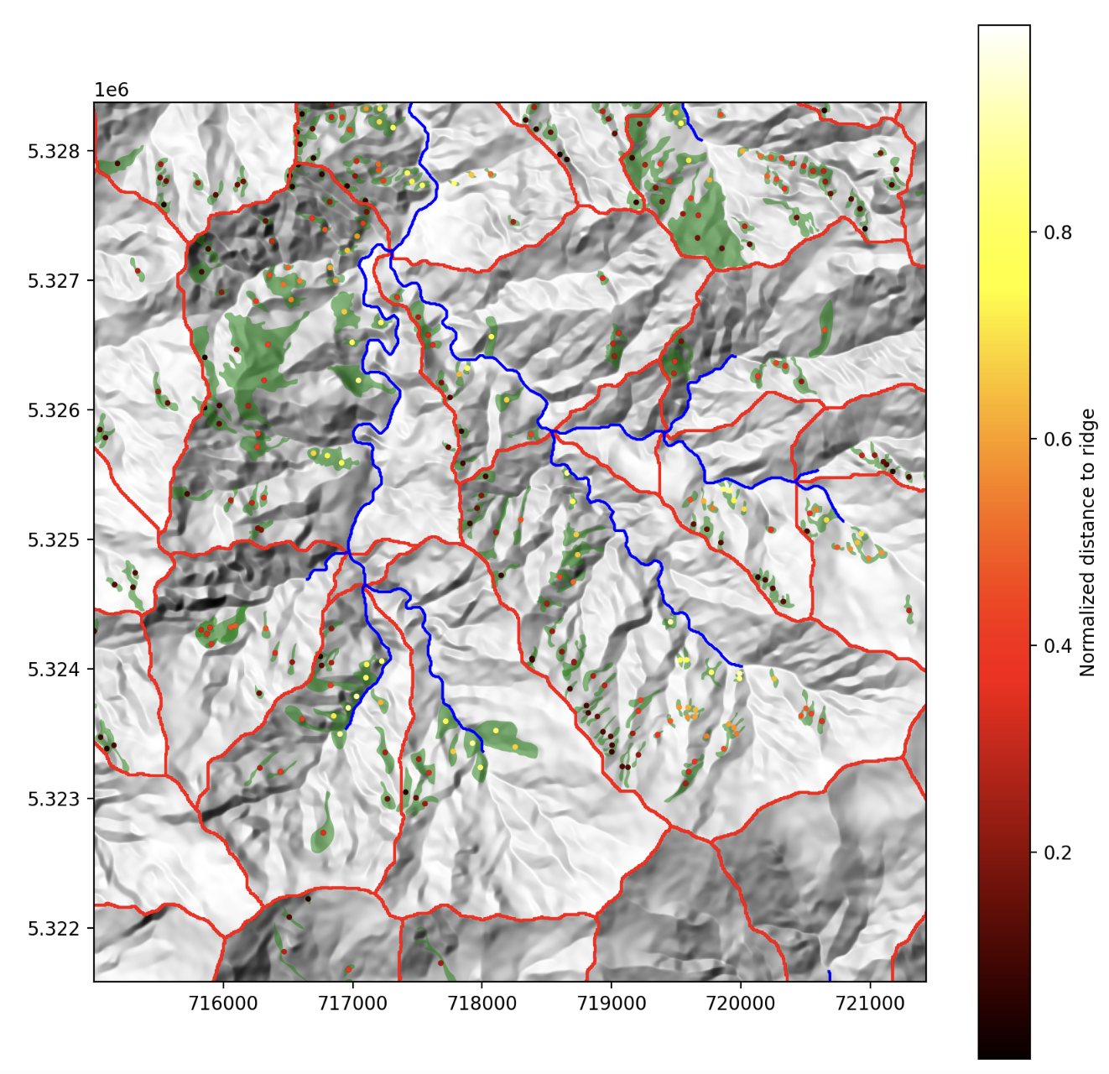
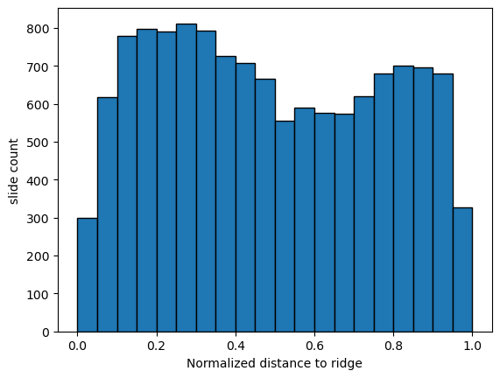
Do landslides happen closer to ridges?
Maybe slightly, but the method is a little too imprecise at this point
Ridge ……………...… River

Slide 22
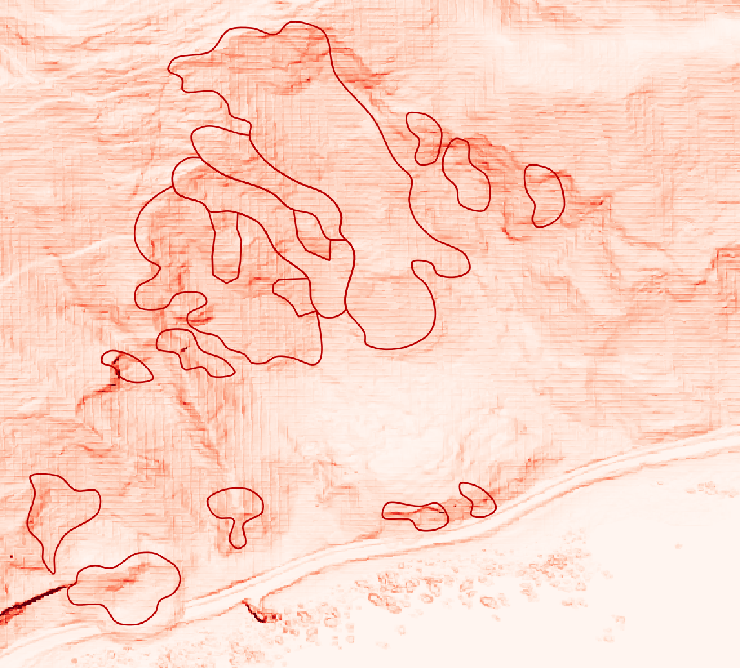
Does morphology correlate with reactivation?
Deformation and surface roughness

Slide 23
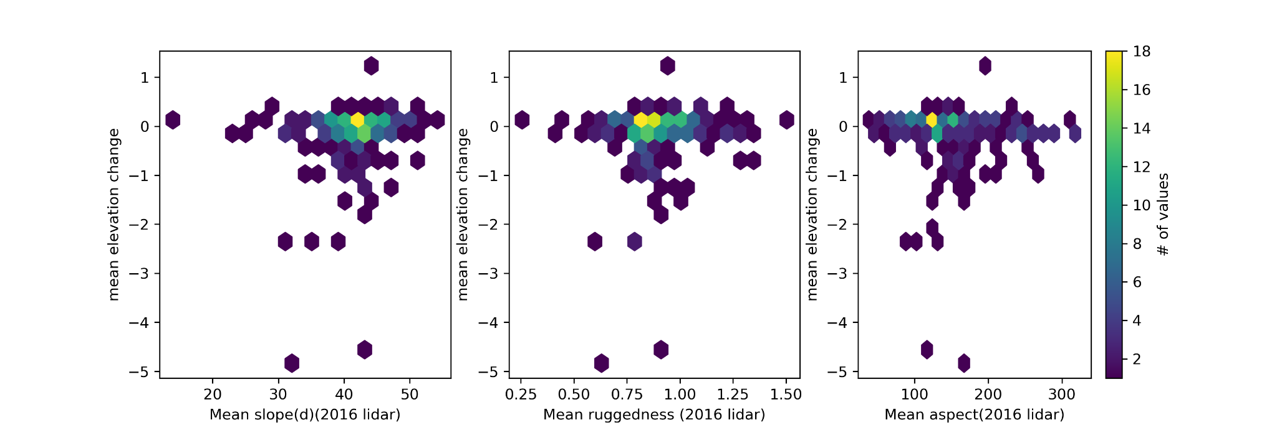
Are landslide reactivations related to something measurable on the post-event DEM?
Maybe, but we havent’ found it yet…

Slide 24
Aside on future work
Track changes in surface elevation and NDVI over more timesteps.
Correlate the reactivation - difference map with the multimodal failure (mode of failure).
s

